Slide 1

Crime Rate Analysis in TORONTO
Mini Project
Using Pandas and Numpy Packages in Python
By
Kumar Chamarty (chamarty.Kumar1@gmail.com)
Under the supervision of Tareq J

Slide 2

Background and Objective ….
Background:
We have used the Homicide data set from the year 2004 to 2018.
The data has been downloaded from http://data.torontopolice.on.ca/search?collection=Dataset&q=Homicide
The data consists of basic information such as different types of homicides committed, when they were committed and where they were committed.
Objective:
To demonstrate basic data analytical skills in Python using different Python Packages.
Read the raw data from source, clean it and convert to a structured format ( in this scenario, a ‘Data Frame’.
Analyze the data and gain insight into various attributes that are available.
Determine or Identify
The safest Neighbourhood to live in Toronto.
Which Police Division may need more resources

Slide 3






Various Tools and Packages used to accomplish this Project

Slide 4
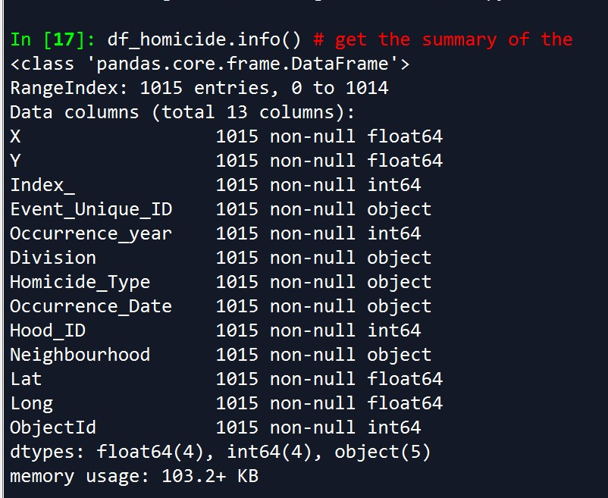
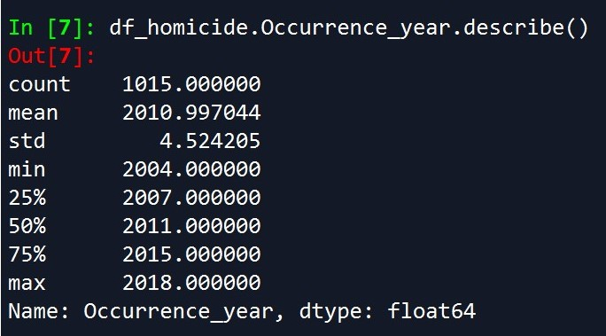
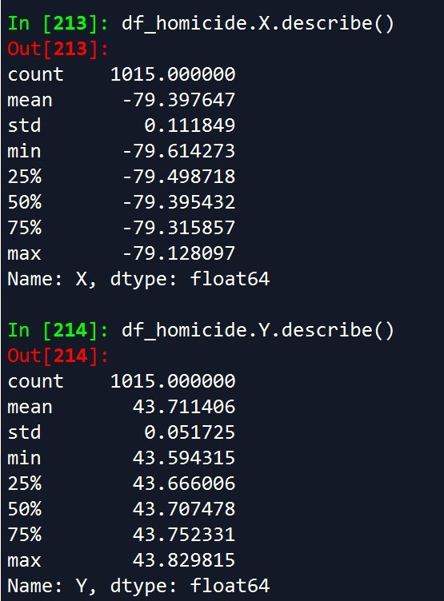
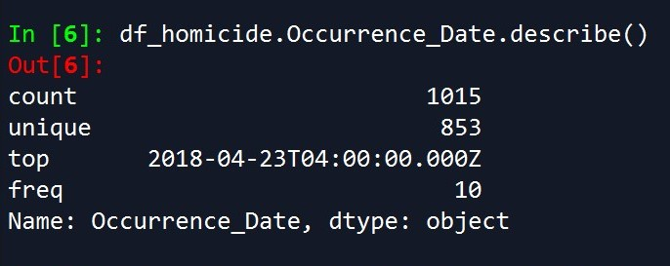
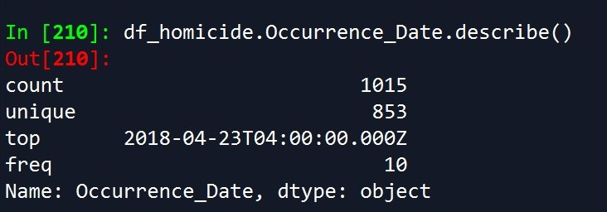
Summary Of Data set

Slide 5
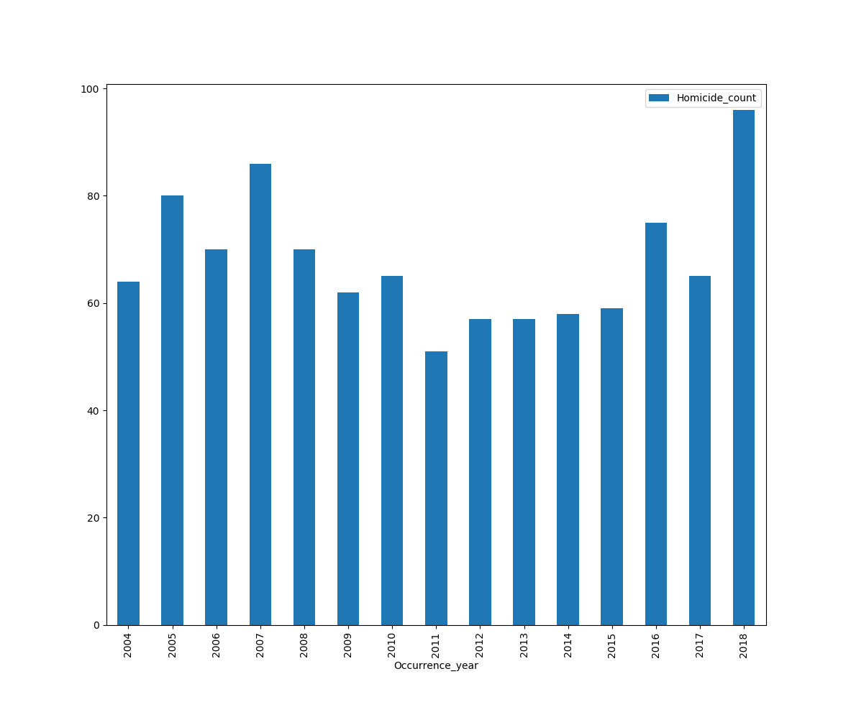
Analysis Q1: Total number of Homicides by year Viz: Bar Graph

Slide 6
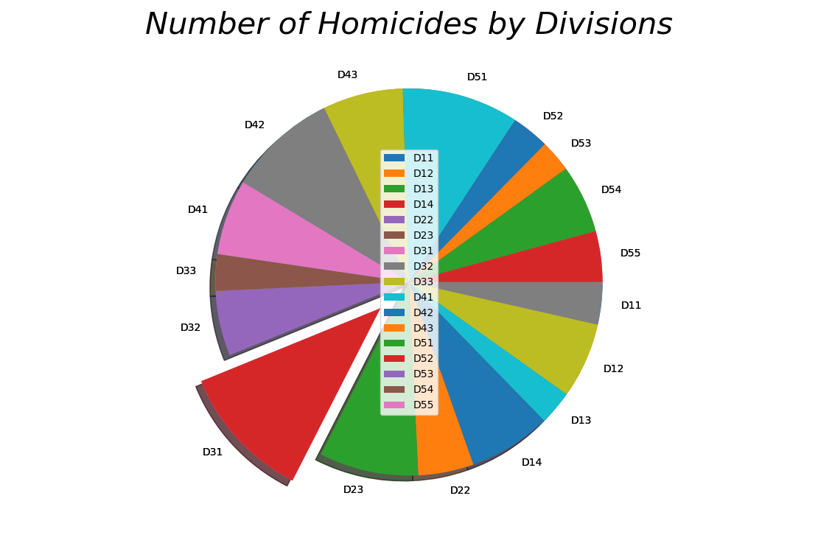
Analysis Q2: Total number of Homicides by Divisions Viz: Bar Pie chart

Slide 7
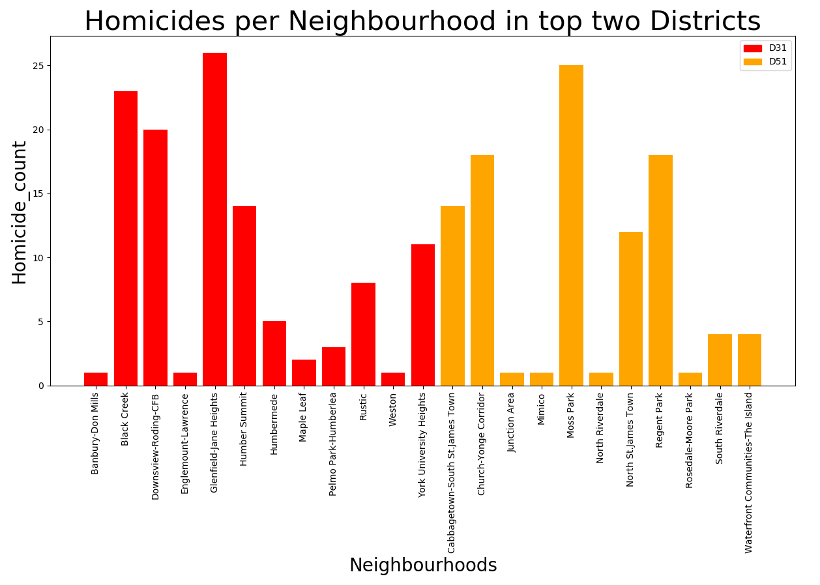
Analysis Q3: number of Homicides by Neighborhoods for top two divisions Viz : SeQUENTIAL BAR GRAPH

Slide 8
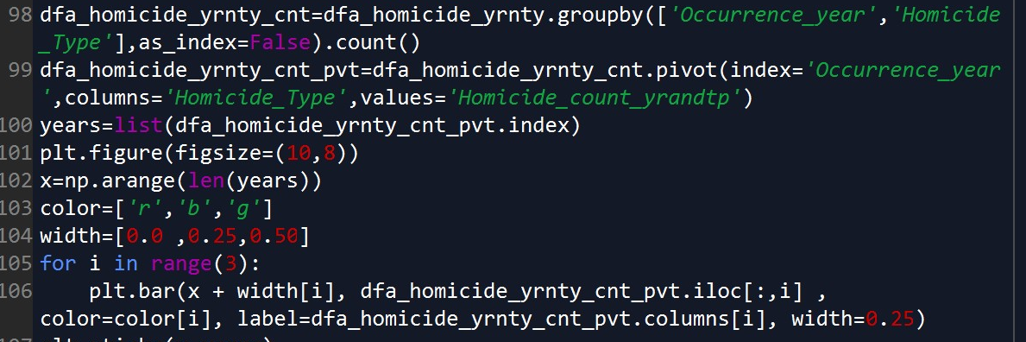
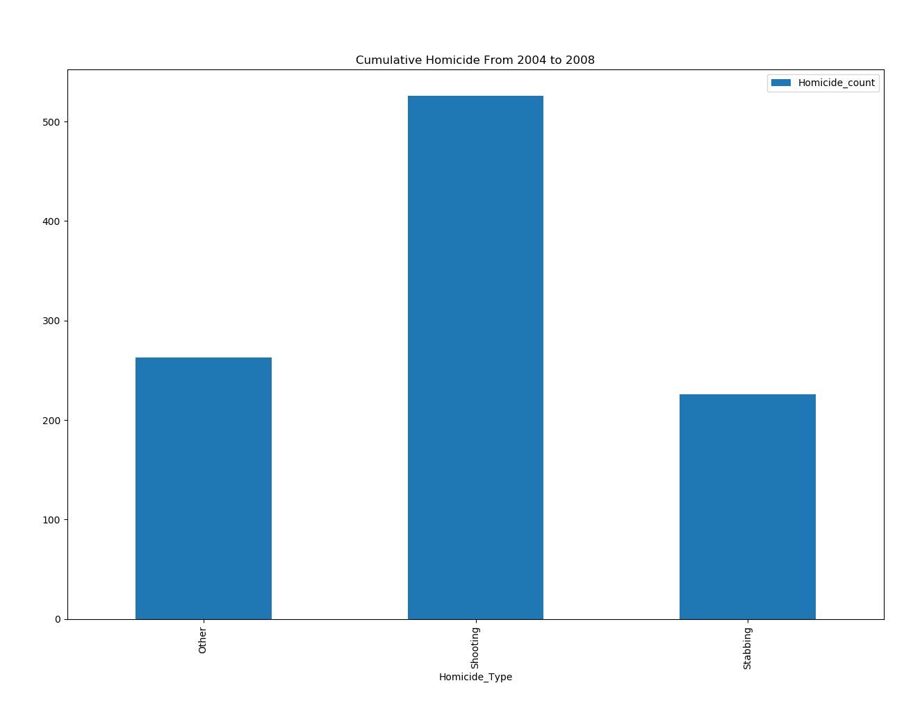
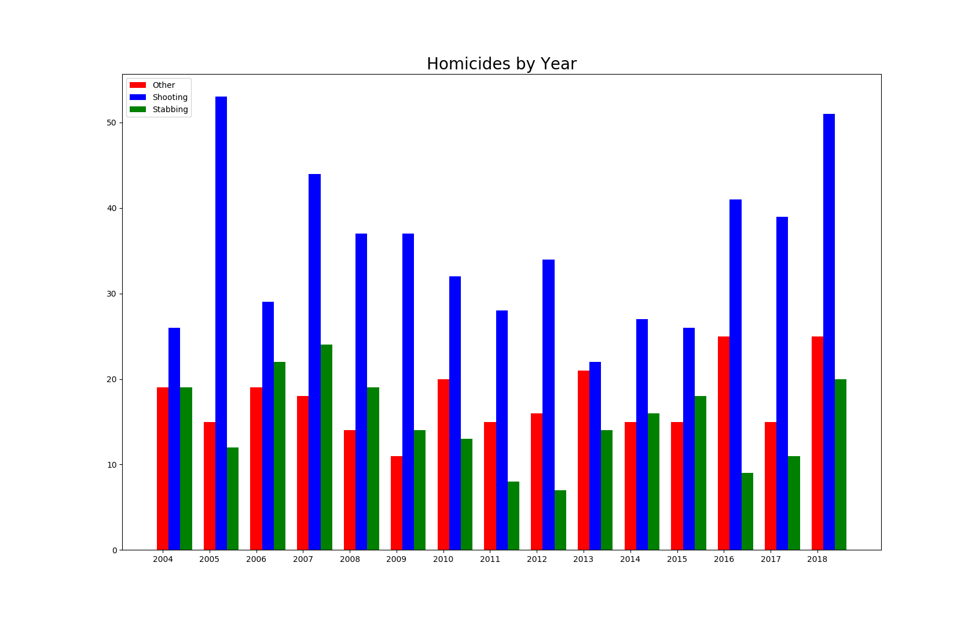
Analysis Q4: Guns Vs Knives

Slide 9
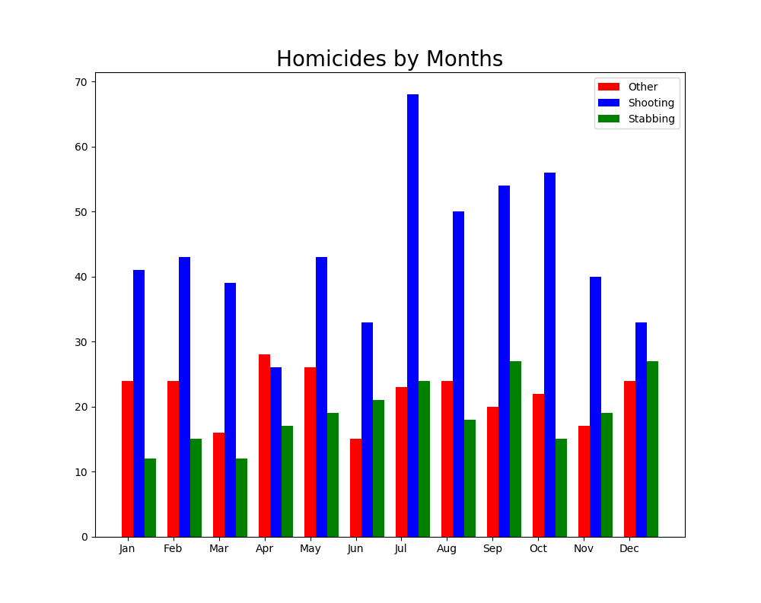
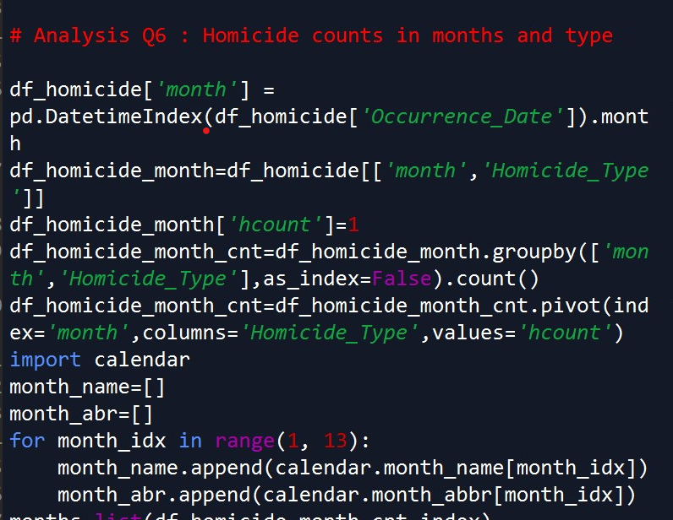
Analysis Q5: Guns Vs Knives II

Slide 10
Compare Homicide rate control/Progression across all the Divisions Over the years
In order to get the best understanding of this analysis, we wanted to use the concept of heat maps. To achieve this,
We used the concept of Geo Plotting and the Geo Pandas package
We identified the various Districts (downloaded and used the shape file from the Toronto Police Service open Data).
Calculated the year wise cumulative of Homicides per division.
Plotted those cumulative/Progression using GeoPandas Geo DataFrame.

Slide 11
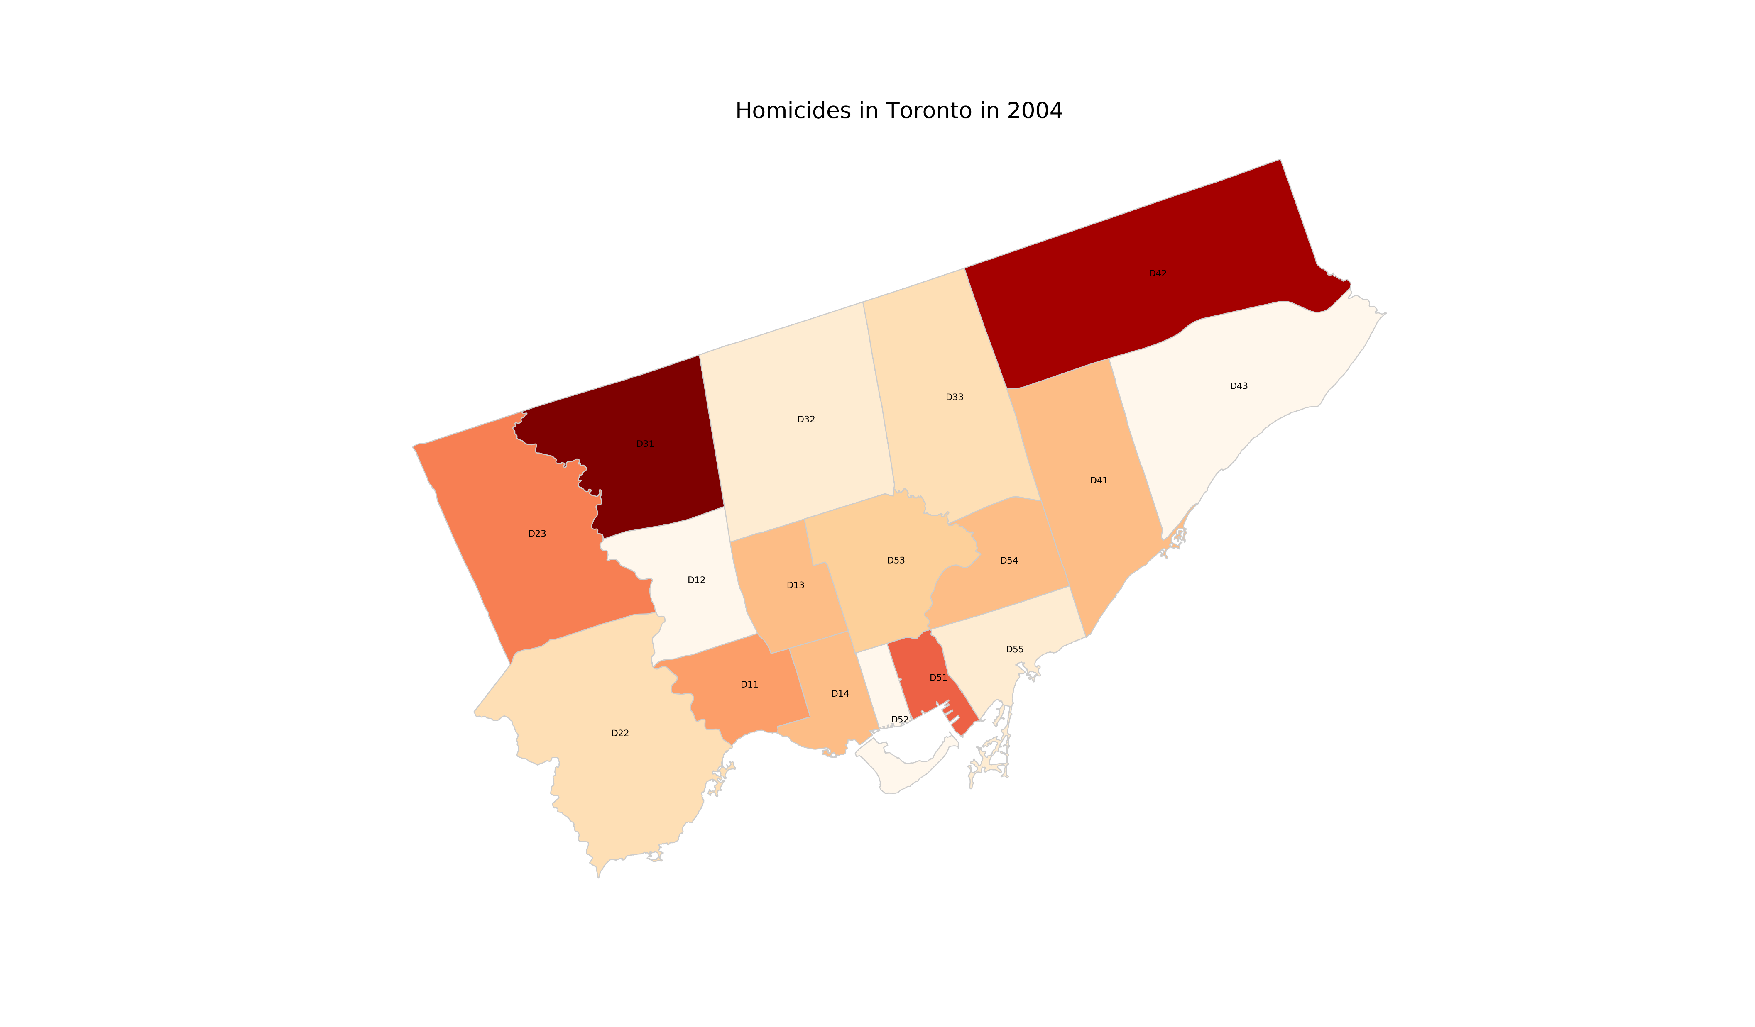
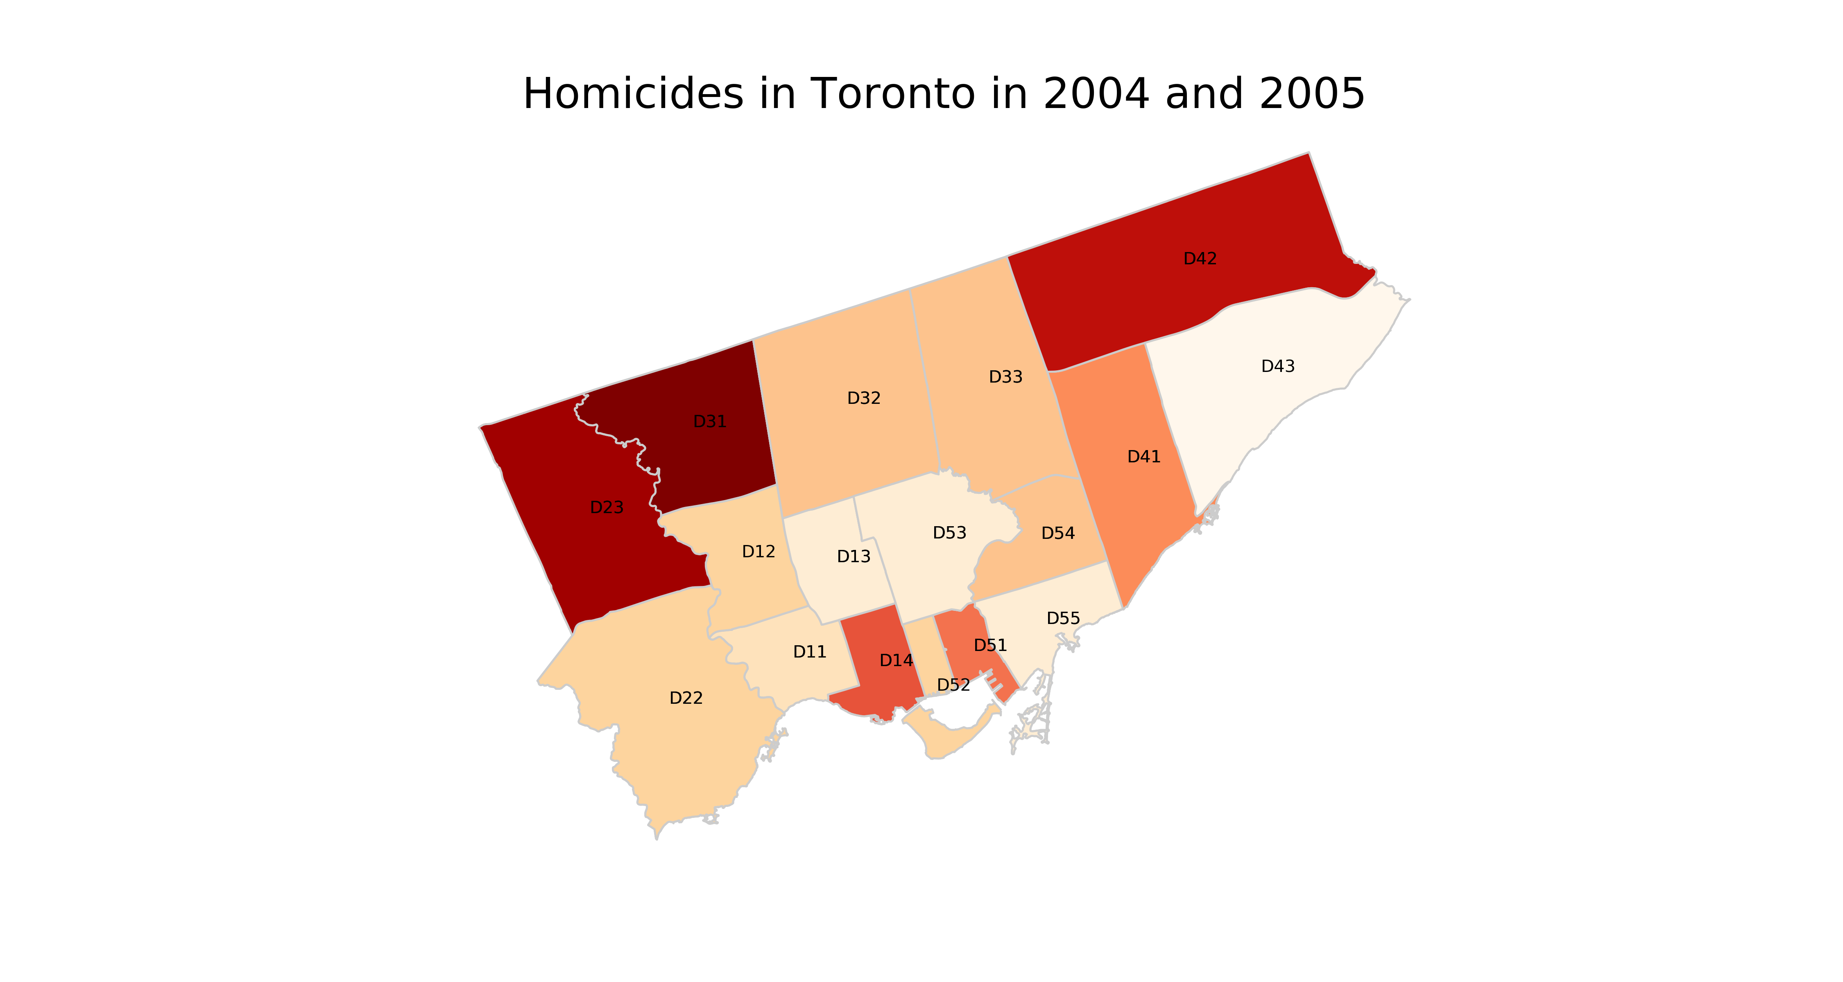
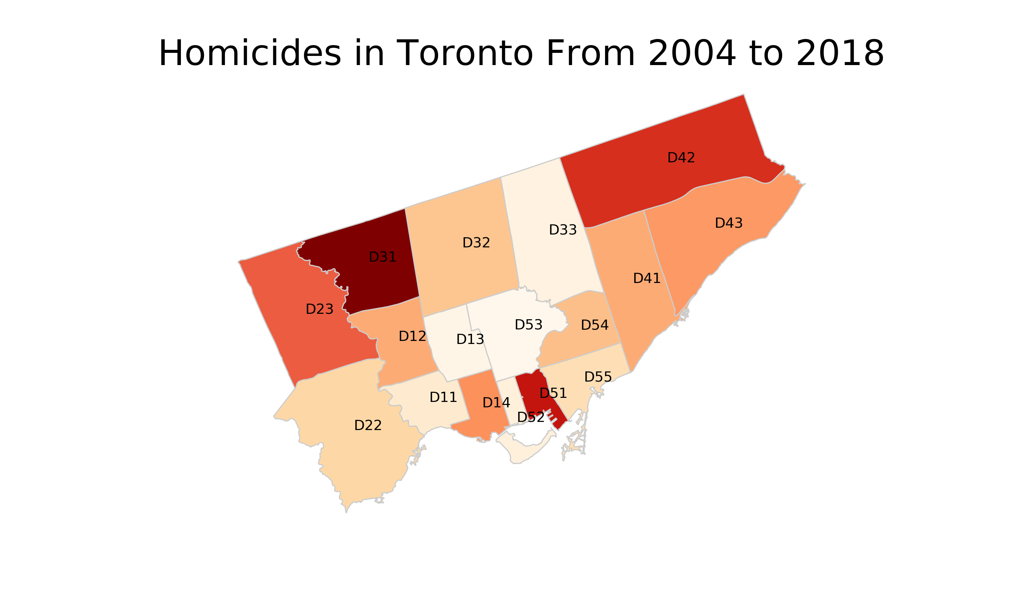


Slide 12
Conclusion:
Division ‘D31’ - division most prone to Homidicdes and not much improvement observed since 2004.
Relatively, positive progression observed in divisions like D13 and D11
Relatively, downward trend observed in divisions like D12 and D42
Gun Violence has been the primary reason for Homicides across all districts.
Most of the Homicides tend to occur in the Month of July.
The top 5 safe neighborhoods to live in Toronto w.r.t Homicides are
Forest Hill North in D13
Bedford Park-Nortown,
Forest Hill North in D51
Playter Estates-Danforth and
Yonge-Eglinton.

Slide 13















